Slide 1
Lecture 10 Binary Search Tree
Abrar Hasan
Lecturer
Dept. of Software Engineering
Daffodil International University

Slide 2
Table of contents
01
02
03
<
T
0
>
Deletion
Binary Search Tree
Insertion

Slide 3
Pre Order
<
T
3
>
A
(Root, Left Child, Right Child)
B
C
D
E
H
G
H
I
J
Pre Order: A,B,D,E,H,C,F,I,G,J

Slide 4
In Order
<
T
3
>
A
(Left Child, Root, Right Child)
B
C
D
E
H
G
H
I
J
In Order: D,B,E,H,A,I,F,C,J,G

Slide 5
Post Order
<
T
3
>
A
(Left Child, Right Child , Root)
B
C
D
E
F
G
H
I
J
Post Order: D,H,E,B,I,F,J,G,C,A

Slide 6
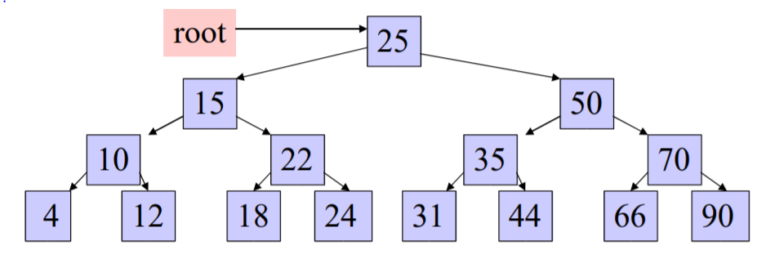
Exercise Traversal
<
T
3
>

Slide 7
<
T
3
>
Answer
InOrder (root) visits nodes in the following order:
4, 10, 12, 15, 18, 22, 24, 25, 31, 35, 44, 50, 66, 70, 90
A Pre-order traversal visits nodes in the following order:
25, 15, 10, 4, 12, 22, 18, 24, 50, 35, 31, 44, 70, 66, 90
A Post-order traversal visits nodes in the following order:
4, 12, 10, 18, 24, 22, 15, 31, 44, 35, 66, 90, 70, 50, 25

Slide 8
01
BST
<
T
1
>
Brief Description about Binary Search Tree

Slide 9
Binary Search Tree
<
T
1
>
Binary Search Tree is a node-based binary tree data structure which has the following properties:
=>The left subtree of a node contains only nodes with keys lesser than the node’s key.
=>The right subtree of a node contains only nodes with keys greater than the node’s key.
=>The left and right subtree each must also be a binary search tree.
8
3
20
9
23
1
6
??
21
7
What Should be here??

Slide 10
02
Insertion
<
T
2
>

Slide 11
Insertion
<
T
2
>
Always insert new node as leaf node.
2. Start at root node as current node.
3. If new node’s key < current’s key.
1. If current node has a left child, search left.
2. Else add new node as current’s left child.
4. If new node’s key > current’s key.
1. If current node has a right child, search right.
2. Else add new node as current’s right child.

Slide 12
Insertion
<
T
2
>
24
7
5
Always insert new node as leaf node.
2. Start at root node as current node.
3. If new node’s key < current’s key.
1. If current node has a left child, search left.
2. Else add new node as current’s left child.
4. If new node’s key > current’s key.
1. If current node has a right child, search right.
2. Else add new node as current’s right child.
8
3
20
1
6
9
23

Slide 13
03
Deletion
<
T
3
>

Slide 14
Deletion
<
T
3
>
There are 3 possible cases

Slide 15
Case 1: Deleting the leaf node
<
T
3
>
8
Just free the allocated memory.
No need to modify the other part of the tree
3
20
1
6
9
23
5
24
7

Slide 16
Case 2: Deleting the node with single child
<
T
3
>
8
Replace the node with child node
3
20
1
6
9
23
5
24
7

Slide 17
Case 2: Deleting the node with multiple child
<
T
3
>
13
9
20
6
11
23
24
5
7
10
12

Slide 18
Case 2: Deleting the node with multiple child
<
T
3
>
13
Way 1:
Replace the node with the largest element of the left Subtree
9
20
6
11
23
24
5
7
10
12

Slide 19
Case 2: Deleting the node with multiple child
<
T
3
>
Way 2:
Replace the node with the smallest element of the Right Subtree
13
9
20
6
11
23
24
5
7
10
12

Slide 20
Case 3: Deleting the node with multiple child (Special Case)
<
T
3
>
13
9
20
6
11
23
Largest
24
5
12

Slide 21
Case 3: Deleting the node with multiple child (Special Case)
<
T
3
>
13
9
20
6
11
23
Smallest
24
5
12

Slide 22
<
T
3
>
Any Question?

Slide 23
Thank You
<
T
3
>

